Slide 1


JavaScript OOP: Course Introduction
Course Program, Evaluation, Exams, Resources
Telerik Software Academy
Learning & Development Team
http://academy.telerik.com

Slide 2

Table of Contents
What is next in the Academy?
The JavaScript OOP Course Program
Exams and Evaluation
Standard Criteria
Resources for the Course

Slide 3

JavaScript OOP
About to make the next step

Slide 4

What's Coming Next?
JavaScript OOP
Continuation of JavaScript UI & DOM
Diving into design of modern JS apps
Pretty much the same
Lectures 2 times a week
Practical exam after two weeks
The course exam
Yet to be discovered

Slide 5

JavaScript OOP: Course Program
Material to cover during the course

Slide 6
JavaScript OOP: Course Program
"JavaScript OOP" course introduction
Course Program, Exams, Evaluation
Functions and Function Expressions
Advanced topics about functions
Immediately-invoked function expressions
Scopes
Closures
Modules

Slide 7


JavaScript OOP: Course Program (2)
Classical OOP in JavaScript
Function constructors
Methods and fields
Hidden/public data
Performance
Inheritance with Classical OOP
Implementing inheritance in JS
The prototype chain

Slide 8

JavaScript OOP: Course Program (3)
Modules and Patterns in JavaScript
Modules
Revealing Module pattern
AMD and Require.JS
Asynchronous Module definition
Dependent modules with Require.JS
Lazy loading

Slide 9
JavaScript OOP: Course Program (4)
Creating and Using Exceptions
Try-catch blocks
Using built-in exceptions
Creating custom exceptions
Exam preparation
Solving tasks for the exam
Practical exam

Slide 10





Evaluation
Thank God There Are Bonuses!

Slide 11

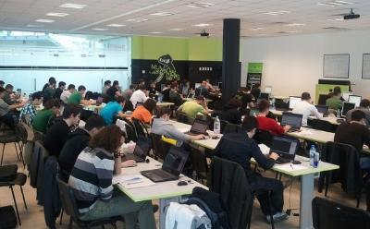
JavaScript – Evaluation
Evaluation components
Practical exam – 65%
Homework – 15%
Homework evaluation – 10%
3 peer reviews per homework
Attendance in class – 10%
Bonuses
Forums activity – bonus up to 5%

Slide 12








Resources
What We Need in Addition to this Course Content?

Slide 13
JavaScript Resources
Mozilla Development Network (MDN)
https://developer.mozilla.org
Mostly used for the presentations
Web Platform
http://www.webplatform.org
The place where all masters contribute
Adobe, Apple, Facebook, Google, HP, Intel, Microsoft, Mozilla, Nokia, Opera, W3C

Slide 14
Course Web Site & Forums
Register for the "Telerik Academy Forums":
Discuss the course exercises with your colleagues
Find solutions for the exercises
Share source code / discuss ideas
The JavaScript Fundamentals official web site:
http://forums.academy.telerik.com/front-end-development/javascript-oop
http://academy.telerik.com/student-courses/web-design-and-ui/javascript-oop

Slide 15
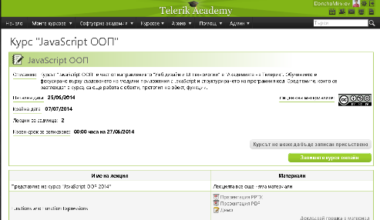
Telerik Integrated Learning System (TILS)
The Telerik Integrated Learning System (TILS)
www.telerikacademy.com
Important resource for all students
Homework submissions
Homework peer reviews
Presence cards with barcode
Reports about your results
telerikacademy.com/Courses/Courses/Details/179

Slide 16



Required Software
Software needed for this course:
Microsoft Visual Studio 2013 or Visual Studio Express 2013 (free version of VS 2013)
Sublime Text 2/3
WebStorm
Komodo IDE
Notepad ++

Slide 17



JavaScript OOP Course Introduction
http://academy.telerik.com

Slide 18



Free Trainings @ Telerik Academy
Web Design and UI Technologies @ Telerik Academy
html5course.telerik.com
Telerik Software Academy
academy.telerik.com
Telerik Academy @ Facebook
facebook.com/TelerikAcademy
Telerik Software Academy Forums
forums.academy.telerik.com

